Slide 1
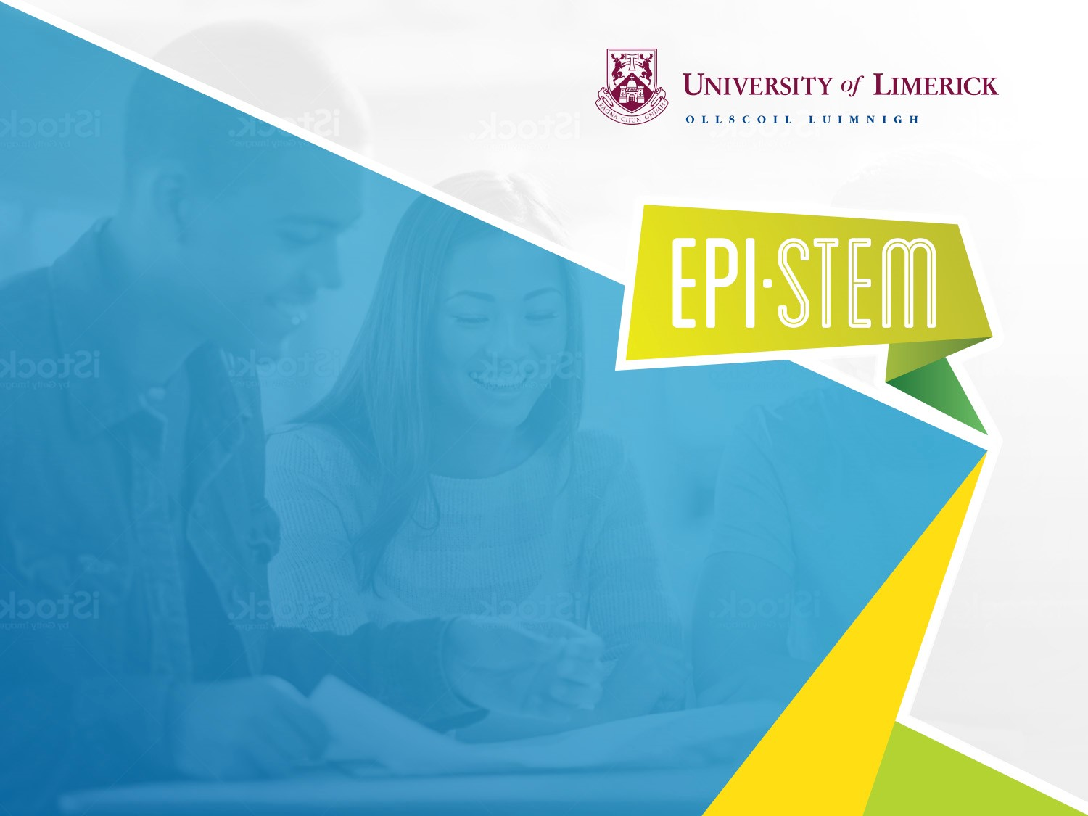



Chemistry of the Atom
& CPD for Science Teachers
Science Literacy Across the Curriculum
NARRATOR: Geraldine Mooney Simmie PhD BSc MSc HDE
THIS IS A HEA FUNDED CPD PROJECT WITH EPI•STEM: @GMooneySimmie

Slide 2


Overview of Topics
Continuing Professional Development [CPD} for Science Teachers and Chemistry Teachers
Active Pedagogy: Knowledge – Identity - Intersectionality
Science Literacy Across the Curriculum [Nature of Science]
The Chemistry of the ATOM
Take Home Messages

Slide 3
CPD resources for science teachers’ professional development
Purposes of on-line CPD resources [Teacher Professional Learning]
Flexible teacher-led CPD in relation to teaching science to young people
Connection to self (being and becoming) and the world (Brady, 2022)
Teacher learning: space for transformative possibility [Mooney Simmie 2021; Mooney Simmie et al. 2019]
Teacher Learning
Upskilling Science Content Knowledge
Lessons from foundation studies

Slide 4
CHEMISTRY LESSONS: on-line CPD resources
Active Pedagogies: teaching chemistry to young people
Upskilling in chemistry content knowledge and skills [learning outcomes]
Good overview of chemistry: interplay of 118 elements, reactions & prediction
Knowledge & Identity Negotiation (Lingard, 2007): productive pedagogy
Recognition of all and of ‘difference’ [intersectionality]
knowledge
skills
identity

Slide 5
CHEMISTRY LESSONS: on-line CPD resources
Lessons from the History of Education
Intersection issues: Science Education of Women and Girls & Trans & People of Colour
Reliance on Thought Experiments [science philosophers; physicists]
History of Chemistry [in-context] e.g. ATOM {400BC to 2017AD}
1571 | Swedish Church Ordinance | Schooling for all | Starting to include
1889 1939 | First Woman Professor First Woman Professor | Sweden Cambridge & Oxford | higher education
1970s | Sex Discrimination Legislation | starting | In Ireland, Europe, US elsewhere
1732 1874 1965 | First (Italian) Woman Graduate First (Russian) Woman Graduate First (US) Woman Graduate | PhD PhD PhD | Science Mathematics Computer Science
1983 | Black Woman Graduate | PhD | Mechanical Engineering

Slide 6
CHEMISTRY LESSONS: on-line CPD resources
Science Literacy Across the Curriculum: e.g. Intellectual Challenge
Teaching Chemistry to Young People for Deep Learning and Deep Democracy
Sjöström and Eilks (2021, p.82) adapted from Roberts (2007)
Vision III critical-reflexive understandings, new activist imaginary
Vision II science-in-context, skills, self as explainer, science, technology and society
Vision I solid foundation, disciplinary knowledge, structure of science, correct explanations

Slide 7
An Overview of Chemistry
The formulation of the Periodic Table, a matrix of columns called Groups and rows called Periods that help chemists predict, and explain how the 118 elements in the Table with react with one another and under what specific conditions
U-tube short videos; downloadable & interactive Periodic Tables
https://pubchem.ncbi.nlm.nih.gov/periodic-table/

Slide 8

Discovery of the Atom
2,400 years – from 400BC to 2017AD
Thought Experiments [Democritus, 400BC]
Connection with a variety of pedagogical approaches [engagement, motivation]

Slide 9
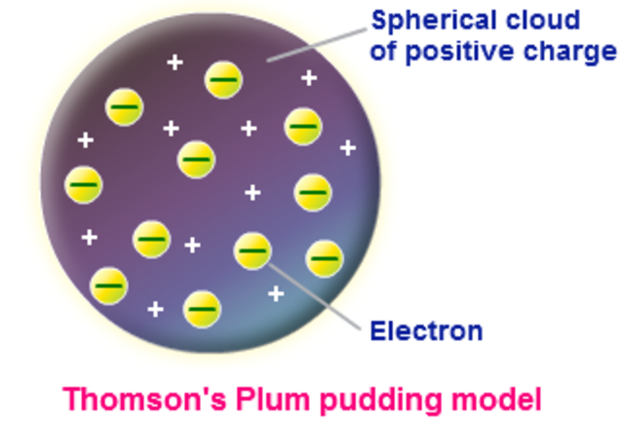
CHEMISTRY LESSONS: on-line CPD resources
DISCOVERY OF THE ATOM
1807 John Dalton
Matter composed of indivisible
building blocks (Teacher)
1903 JJ Thompson
Pudding of positive sphere with
Negative electrons (plums) dispersed
throughout(Physicist)

Slide 10
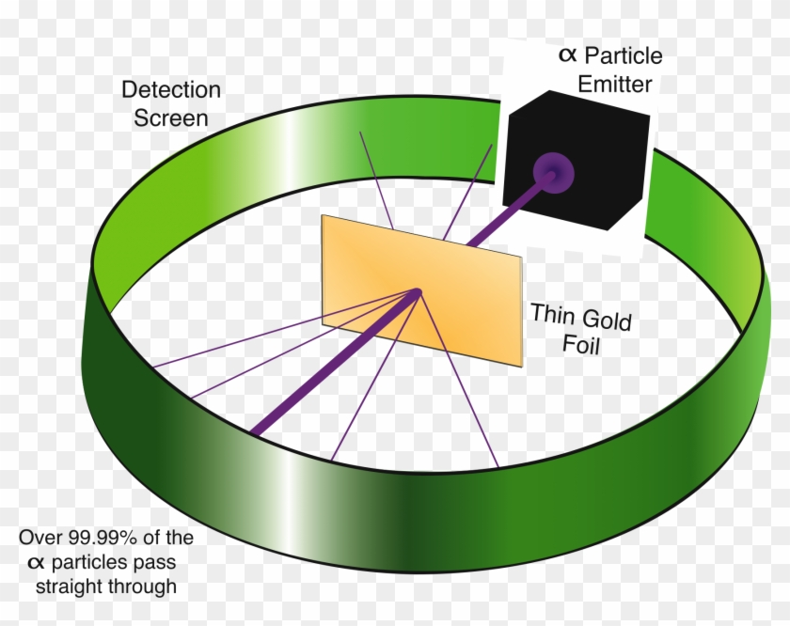
CHEMISTRY LESSONS: on-line CPD resources
DISCOVERY OF THE ATOM
Ernest Rutherford’s [PHYSICIST]1911 gold foil experiment (tests plum pudding model; fires alpha particles at gold foil; expects bounce back; deduced a solid NUCLEUS and most of the atom empty space [electons in orbits]

Slide 11
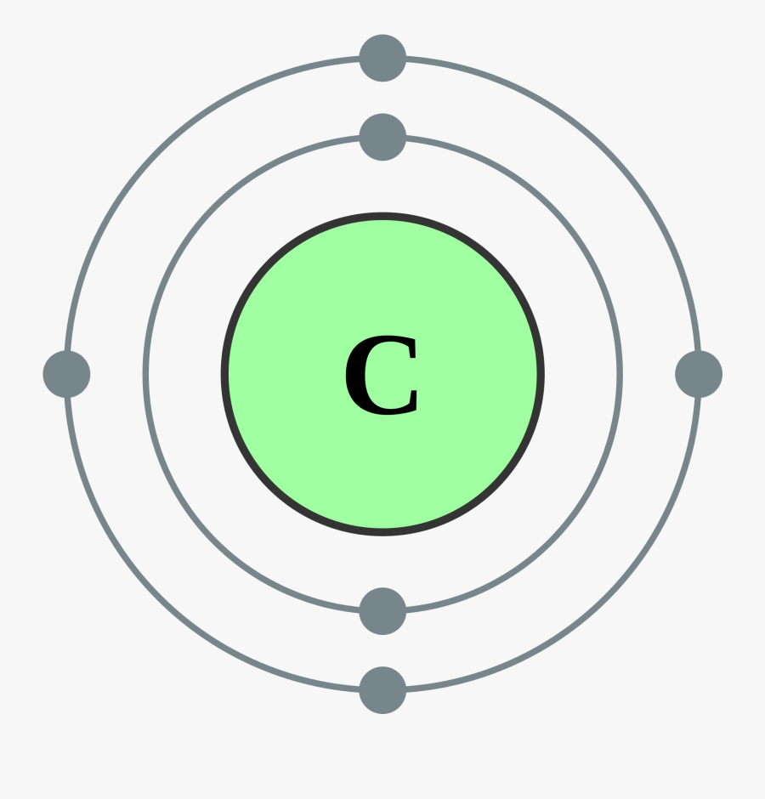
CHEMISTRY LESSONS: on-line CPD resources
AN ATOMIC STRUCTURE THAT IS A GOOD ENOUGH MODEL
[Niels] Bohr Planetary Model of the Atom
(1885-1962) (Physicist)
Nucleus: protons+nucleus
Electons: definite orbits
Emit/Take-in energy moving
e.g. Carbon 2,4 [electrons, shells]
Practical: Atom Diagram
Explains much chemical behaviour

Slide 12
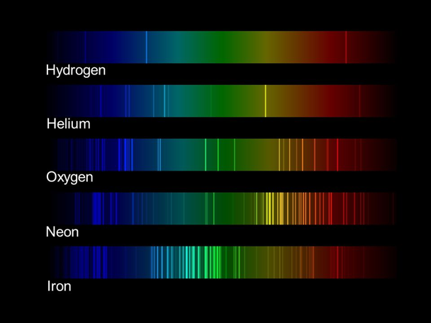
CHEMISTRY LESSONS: on-line CPD resources
THE DISCOVERY OF THE ATOM CONTINUES……
De Broglie (1924) electron has wave properties
Electron can only jump-in a defined step/quanta
Emitting a spectrum of light (E=hf)
Electrons: are waves of probability
Engineers [last 40 years]
Scanning Tunneling Microscope [Gerd Binning & Heinrich Rohrer, Nobel Prize in Physics in 1986, imaging surfaces at the atomic level]
2017 Professor Ara Apkarian, physical chemist and Director of Centre for Chemistry at the Space-Time Limit, California, a National Science Foundation Centre for Chemical Innovation: interrogates single molecules in real time and with atomic spatial resolution e.g. to show an atom of nitrogen
Can we see atoms in 2022? [answer is both yes and no!]

Slide 13
CHEMISTRY LESSONS: on-line CPD resources
DISCOVERY OF THE ATOM: Recommended U-Tube Videos
CaSTL CENTER Chemistry at the Space-Time Limit
A National Science Foundation Centre at the University of California
“What is the Atom and How Do We Know? Stated Clearly
Narrator: Jon Perry 2.3 million views: 12.15 minutes 18th Sept 2018
What Is An Atom And How Do We Know? – YouTube
“A Better Way to Picture Atoms”, 19 May 2021
https://www.youtube.com/watch?v=W2Xb2GFK2yc
3.2 million view, minute physics, 5.35 minutes, 3-D representation

Slide 14
CHEMISTRY LESSONS: on-line CPD resources
Value of Thought Experiments [philosophy]: big ideas, concepts, patterns in chemistry, models to explain the behaviour of atoms - building blocks of chemistry
Role of Empirical Evidence: to prove or refute the big ideas and models
Science Teachers’ CPD take away: take time to think, to reflect, to interplay theory and practice, to intellectualise and theorise not only in your teaching of science and chemistry but in all aspects of your life [encourage your students to do the same; the world urgently needs new thinking and new thinkers]

Slide 15
Bibliography
Brady, A. M. (2022). Being a Teacher From Technicist to Existential Accounts, in conversation with Jean Paul Sartre. Springer.
Lingard, B. (2007). Pedagogies of Indifference. Journal of Inclusive Education, 11 (3), 245-266.
Macrine, S.L. & Fugate, J.M.B. (2022). Movement Matters How Embodied Cognition Informs Teaching and Learning. MIT Press. Cambridge, Massachusetts.
Mooney Simmie, G. (2022). How can the philosophy of education inform STEM Education Policy in schooling and higher education in a post-Covid pluralist and democratic Ireland: Growing back better. In E. Costello, P. Girme, D. Hyland, T. Kaur, O. Kelly, T. McLoughlin, & P. Van Kampen (Eds) Proceedings of the CASTeL 9th STEM Science and Mathematics Education Research Conference 2022 Proceedings (pp. 66-78), Dublin City University. https://doi.org/10.5281/zenodo.6953886
Mooney Simmie, G. (2021). Teacher Professional Learning: a holistic and cultural endeavour imbued with transformative possibility. Educational Review. DOI 10.1080/00131911.2021.1978398 https://doi.org/10.1080/00131911.2021.1978398.
Mooney Simmie, G., Moles, J., & O’Grady, E. (2019). Good teaching as a messy narrative of change within a policy ensemble of superstructures and flows. Critical Studies in Education, 60 (1), 55-72.
Sjöström, J., & Eilks, I. (2021). Chapter 4 Reconsidering Different Visions of Scientific Literacy and Science Education based on the Concept of Bildung. In Y. J. Dori et al. (eds.). Cognition, Metacognition, and Culture in STEM Education, Innovations in Science Education and Technology book series, ISET, (24), 65-88. Springer.

Slide 16
Contact Details
Register for on-line CPD resources: https://epistem.ie
EPI•STEM project: Resources
Contact: Helen Fitzgerald, Senior Executive Administrator
Email: helen.fitzgerald@ul.ie
This on-line CPD project [HEA funded] is an initiative with EPI•STEM for science and mathematics secondary teachers in Ireland. The research-led development team includes:
Geraldine Mooney Simmie, Niamh O’Meara, Merrilyn Goos, Stephen Comiskey, Ciara Lane, Tracey O’Connell, Vo Van De, Tara E. Ryan, Martina Scully, Jack Nealon, Daniel Casey, Keith Kennedy, Annette Forster, Céren O’Connell, Martha Cosgrave, Martina Ryan, Veronica Ryan, Gemma Henstock

